Slide 1


Section 5.1 Areas and Distances
Lecture 1
The second paradox of calculus

Slide 2

Homework Submission to Canvas
Preview of section
Skim the section in text and write a short paragraph summary.
Give a bulleted list of all important definitions, theorems, and formulas without details.
Notes on video lectures
Take notes on everything written on slides including all details, worked examples, on-own activities, as well as your own thoughts and questions.
Try on-own activities first, then write down provided solution next to it for comparison.
Worked examples from the text
Write down the problem and attempt without looking at the solution.
Use the solution to write the best explanation you can.
Solutions to textbook exercises
Model approaches and explanations given in the video lectures and textbook examples.
Final reflection of section
List the key takeaways to remember as a bulleted list.
Video reflection (for some sections)
Write a 1 paragraph reflection on the video discussing what you found most interesting or useful.

Slide 3
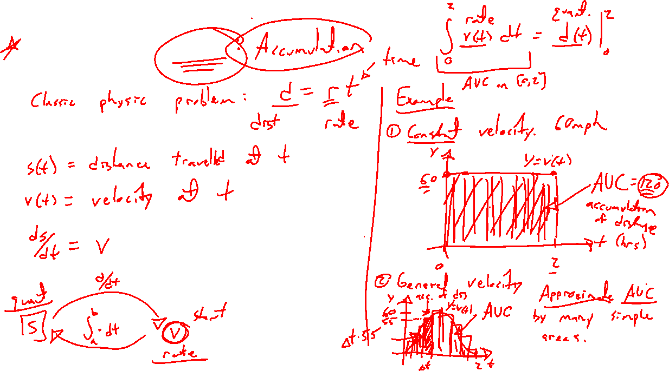
Motivating Area
Notes:
Classic problem of physics: d=r t
S=s(t), we know ds/dt = v. What about the reverse connection?
Constant velocity case, 60mph for 4 hrs. Graph. Distance is AUC.
Changing velocity, can approximate velocity and approximate AUC. Smaller subintervals the better.

Slide 4

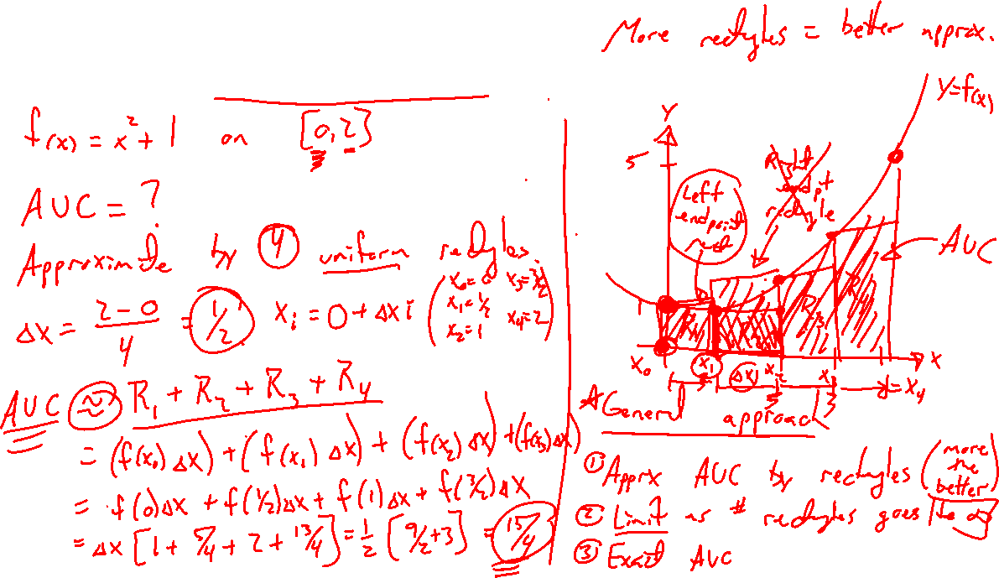
Example: Approximate AUC
Notes:
F(x)=x^2+1 on [0,2]. What is AUC?
Need a general approach:
- approximate by simple shape, 4 rectangles
- limiting process to true solution

Slide 5
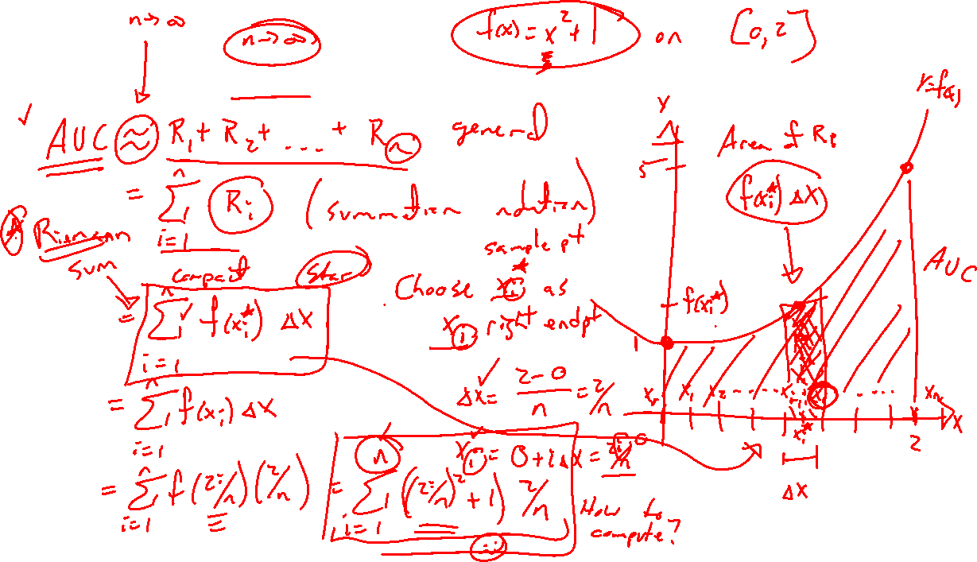
Example: Exact AUC
Notes:
F(x)=x^2+1 on [0,2]. What is AUC?
Need a general approach:
- approximate by simple shape
- limiting process to true solution
- terminology and notation

Slide 6
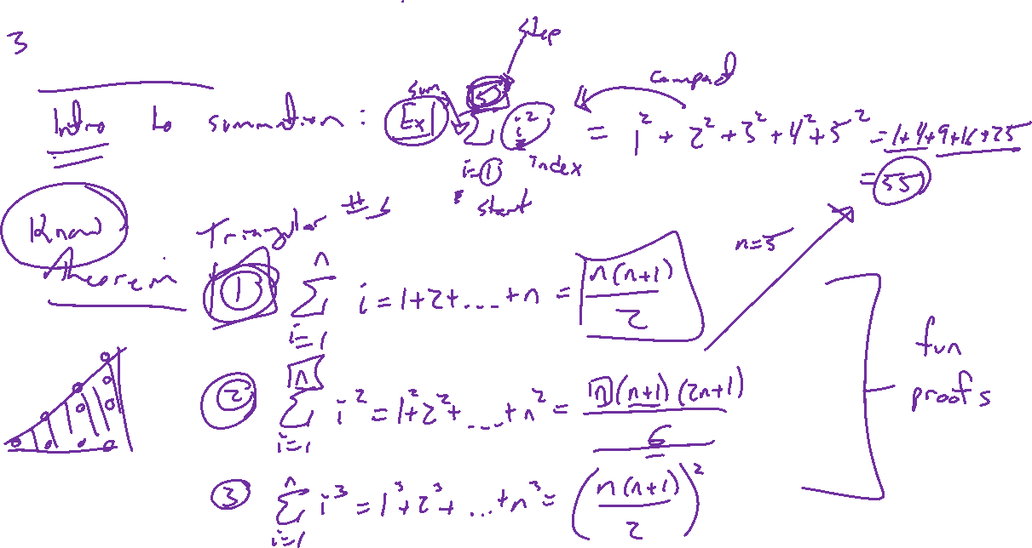
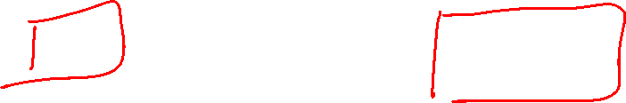
Common summation formulas

Slide 7
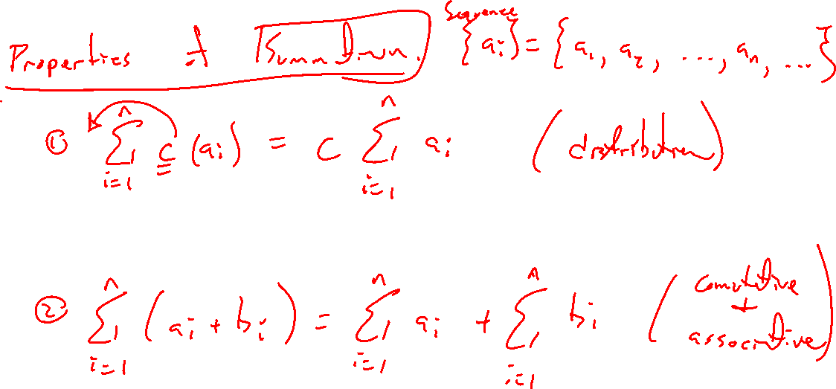

Slide 8
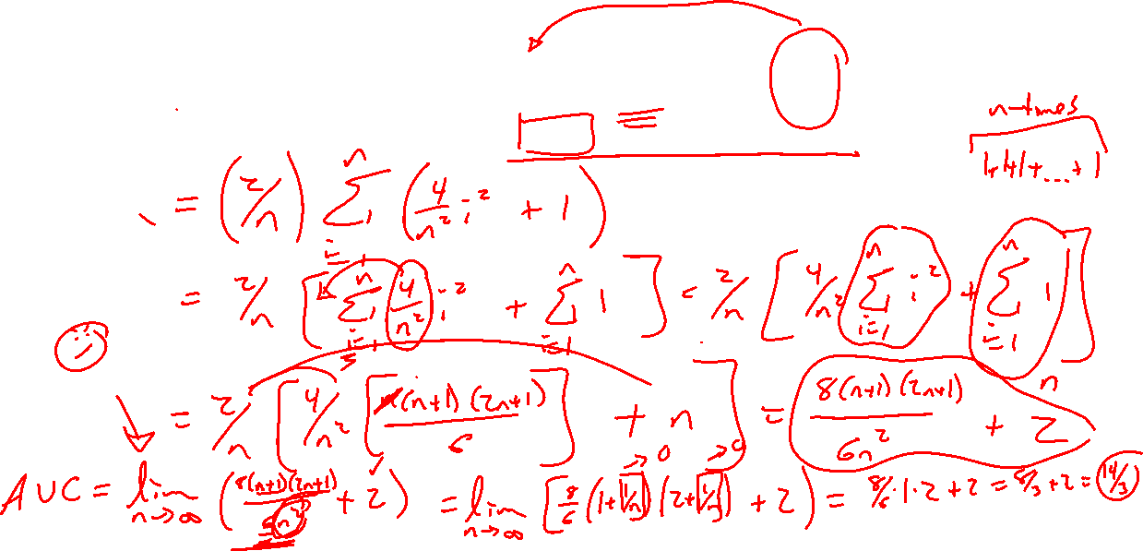
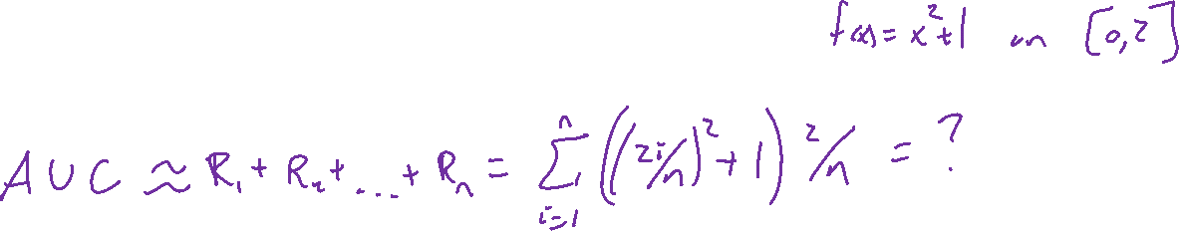
Example: Exact AUC, final story
Notes:
Desmos detour

Slide 9
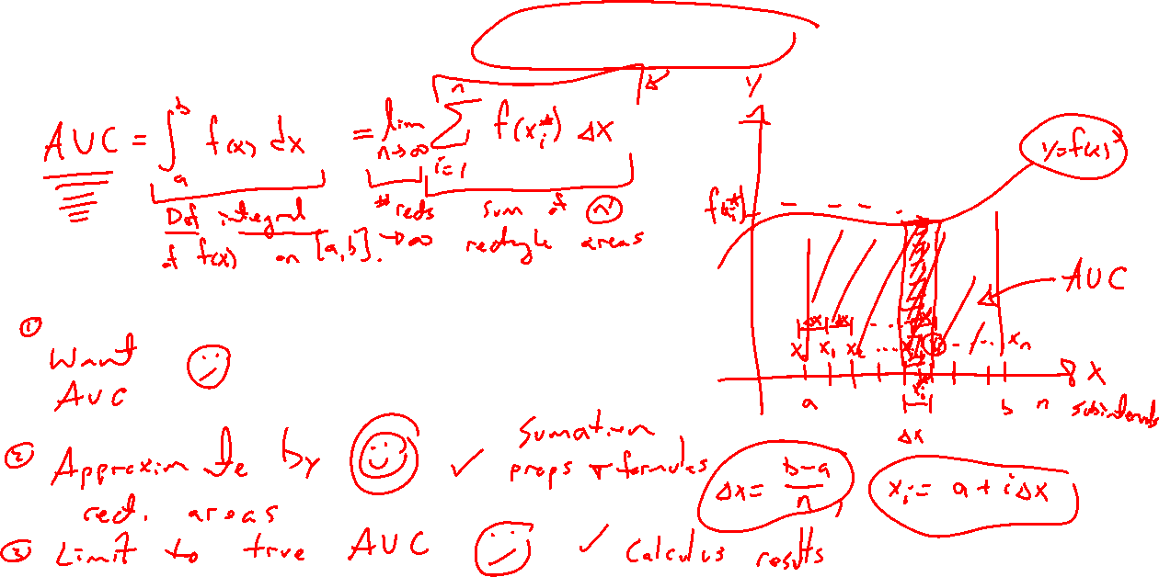
AUC as a limit of a Riemann sum
Notes:
General case. Picture. Take care with notation.

Slide 10
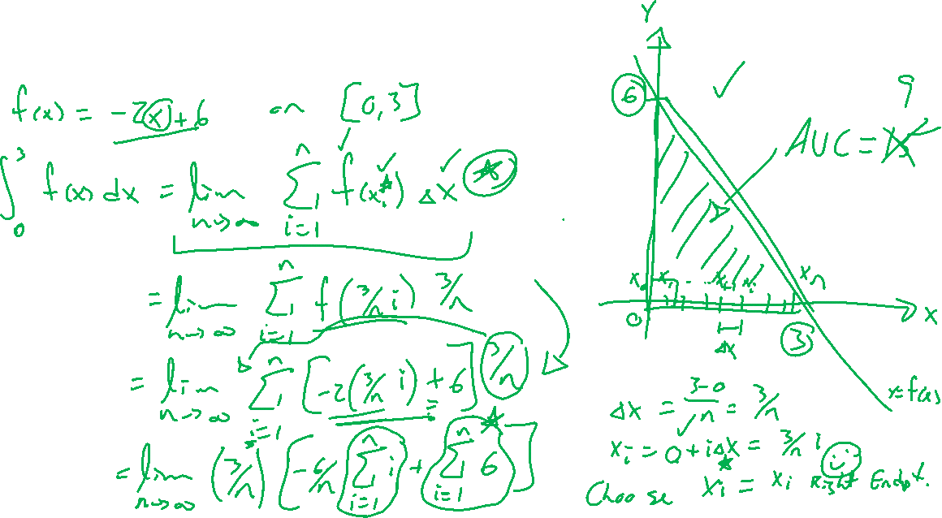
Example: Try on own
Notes:
F(x) = -2x+6 on [0,3]
Check answer via geometry

Slide 11
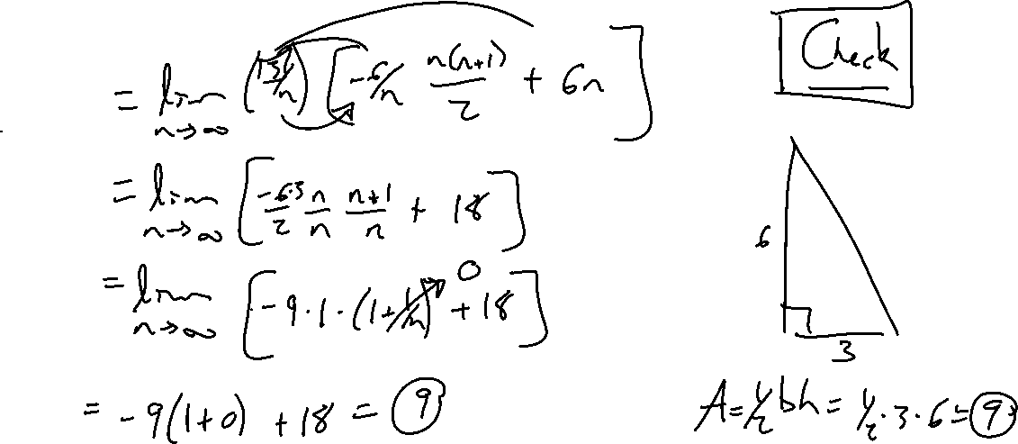
Example: Try on own
Notes:
F(x) = -2x+6 on [0,3]
Check answer via geometry

Slide 12
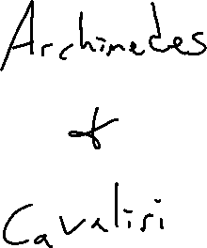
Area thru the ages
Notes:
Archimedes and quadrature of parabola, volume of sphere
Cavaliri principle

Slide 13
Textbook Examples and Exercises
Rework examples 1, 2, 3, 4 in the text. Steps:
Write down a problem.
Close the book and attempt on own.
Check / correct your solution against the text solution.
If needed, rewrite the problem to be of the quality of the text solution.
Complete exercises 5, 13, 21, 25
Write solutions of the same quality as in lecture and text solutions.
Check your solution against the answer in the back of the book.
Video reflection
NONE

Slide 14
Homework Submission to Canvas
Preview of section
Skim the section in text and write a short paragraph summary.
Give a bulleted list of all important definitions, theorems, and formulas without details.
Notes on video lectures
Take notes on everything written on slides including all details, worked examples, on-own activities, as well as your own thoughts and questions.
Try on-own activities first, then write down provided solution next to it for comparison.
Worked examples from the text
Write down the problem and attempt without looking at the solution.
Use the solution to write the best explanation you can.
Solutions to textbook exercises
Model approaches and explanations given in the video lectures and textbook examples.
Final reflection of section
List the key takeaways to remember as a bulleted list.
Video reflection (for some sections)
Write a 1 paragraph reflection on the video discussing what you found most interesting or useful.

